Slide 1

UNIVERSITY INSTITUTE OF TECHNOLOGY.RGPV
DEPARTMENT OF COMPUTER APPLICATION
session : 2020-2022
MAJOR PROJECT
VEHICLE PARKING SYSTEM
SUBMITTED BY :
KANCHAN MISHRA
[0101CA201016]
GUIDED BY :
MR. DHEERESH CHANDRA KUSHWAHA
(Assistant Professor dept. of Computer Application)

Slide 2

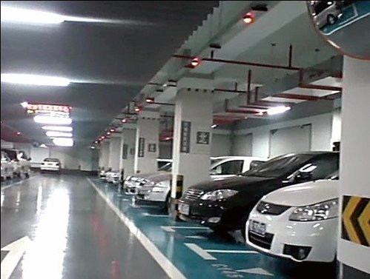
CONTENTS
Introduction
Objective
Scope
Modules
Iterative Model
DFD
E-R Diagram
Sequence Diagram
Use case diagram
Requirements
Technology Used
Conclusion

Slide 3
INTRODUCTION
A Vehicle parking system an easy for admin to retrieve the data if the vehicle has been visited through number he can get that data. Now days in many public places such as malls, multiplex system, hospitals, offices, market areas there is a crucial problem of vehicle parking.
The vehicle parking area has many lanes/slots for Vehicle parking. So to park a vehicle one has to look for all the lanes. Moreover this involves a lot of manual labour and investment. Instead of vehicle caught in towing the vehicle can park on safe and security with low cost.

Slide 4
OBJECTIVE
We can park our vehicle by paying
There is no risk for vehicle owner for parking the vehicle.
In case of my damages and problem of vehicle that will claim at parking.
Determine the parking area is full or not.
Enhances the visitor ‘s experience.

Slide 5
SCOPE
Every place is under the process of urbanization. There are many corporate offices and shopping centers etc. There are many recreational places where people used to go for refreshment. So, all these places need a parking space where people can park their vehicles safely and easily. Every parking area needs a system that records the detail of vehicles to give the facility. These systems might be computerized or non-computerized. With the help of computerized system we can deliver a good service to customer who wants to park their vehicle into the any organization’s premises.
Parking is a growing need of the time. Development of this system is very useful in this area of field. We can sell this system to any organization. By using our system they can maintain records very easily. Our system covers the every area of parking management. In coming future there will be excessive need of Vehicle parking management system.

Slide 6
MODULES
a).Data Records
Staff records: - It helps to provide details of staff that uses the Vehicle parking management System. It provides the descriptions of staffs like: -Staff first, middle and last name, Address , Contact Number , Gender.
User Records: - This record helps for the authorization for using Vehicle Parking Management System. It Provides the Username and Password for the User (staff).It also includes the level of authority that means it separates the normal users and administrator.
Vehicle Records: - This most important record which focuses in our Vehicle Parking Management System. It stores the essential Vehicle records like: -Vehicle Number, Vehicle Type, Vehicle Entry Time, Vehicle Exit Time

Slide 7
b).Reports
Vehicle Parking Detail: - This report is very essential in this system. This report provides a brief summary of vehicle activities. It shows the overall Entry and Exit time. It shows the User at time of Entry and Exit .It also provides the facility for examining the total vehicle details according to date wise.
Transaction Detail:-This report will show the Transaction between the customer and the System. . It shows the cost of the vehicle after using the facility of parking. It will show the number of transaction by date wise. It will also have User at time of the Transaction.

Slide 8
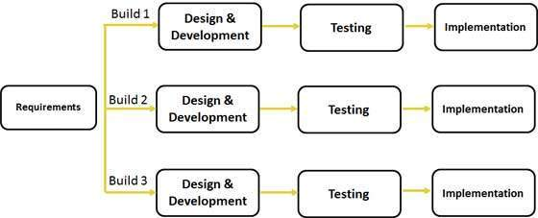
ITERATIVE MODEL DIAGRAM

Slide 9
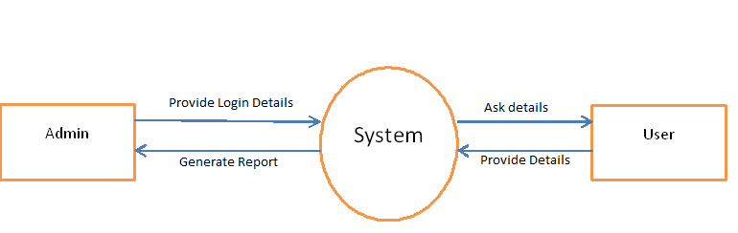
DATA-FLOW DIAGRAM
LEVEL 1 DFD

Slide 10
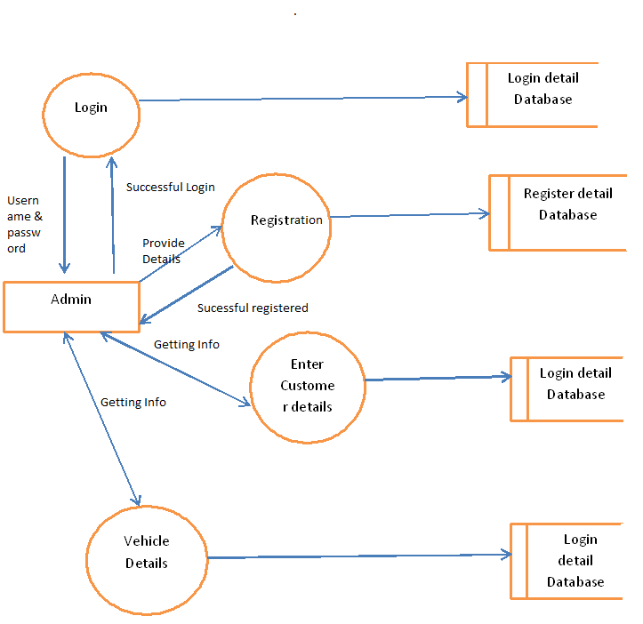
LEVEL 2 DFD

Slide 11
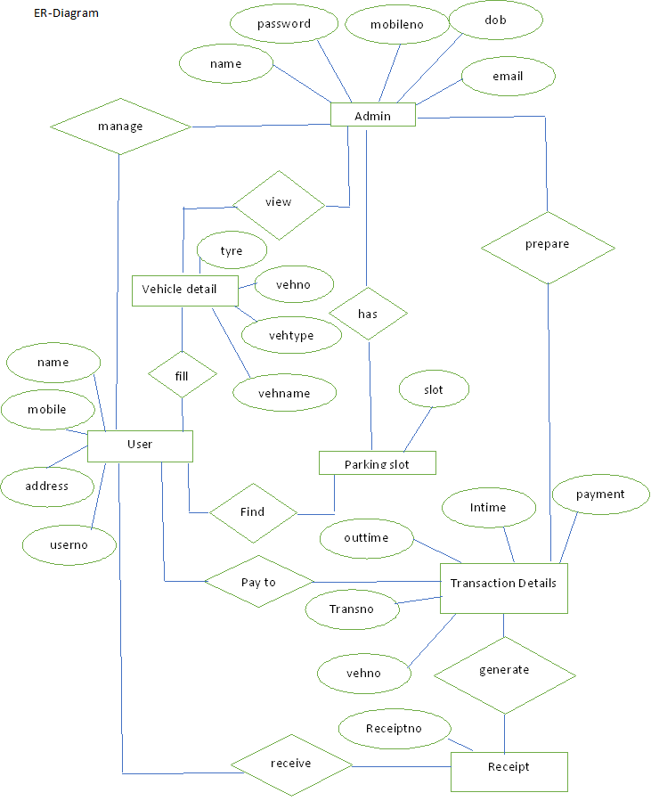

Slide 12
SEQUENCE DIAGRAM

Slide 13
USECASE DIAGRAM

Slide 14
USER REQUIREMNET
Need for an application that makes communicating easy and comfortable.
An application that enables user to park a vehicle with safe and secure.
Need for an application that is easy to use and widely available and hence a web application
Handling all functions done with organization in a computerized manner.
Allowing the user to park the vehicle directly.

Slide 15
FUNCTIONAL REQUIREMNET
Admin need to enter all details for registration.
Admin need to insert all details about customer and vehicle.
Admin need to save all the details of customer and vehicle.
Admin can retrieve the details of customer.
Admin must generate a report for payment.

Slide 16
ACTIVITY DIAGRAM

Slide 17
NON-FUNCTIONAL REQUIREMNET
Usability: These website has appropriate user interface and adequate information to guide the user in order to use the website.
Portability: The website is portable as it is online website running across the net
Flexibility: It is very flexible
Security: This website provide user and authentication so that only the legitimate user are allowed to use the website
Maintainability: These website is capable to secure the data and easily retrieve the data.
Scalability: These system can further modified in future.

Slide 18
TECHNOLOGY USED
FRONT END :
Python GUI
BACK END :
Python
DATABASE :
mysqli

Slide 19
CONCLUSION
This Project is minimizing the task of parking a vehicle by paying and saying some details about customer and vehicle to save data. In this the vehicle is parked as a safe and secure. This project is done as Efficient as possible.

Slide 20


